Slide 1
Divide-and-conquer algorithms

Slide 2
Divide-and-conquer algorithms
We have seen four divide-and-conquer algorithms:
Binary search
Depth-first tree traversals
Merge sort
Quick sort
The steps are:
A larger problem is broken up into smaller problems
The smaller problems are recursively
The results are combined together again into a solution

Slide 3

Divide-and-conquer algorithms
For example, merge sort:
Divide a list of size n into b = 2 sub-lists of size n/2 entries
Each sub-list is sorted recursively
The two sorted lists are merged into a single sorted list

Slide 4
Divide-and-conquer algorithms
More formally, we will consider only those algorithms which:
Divide a problem into b sub-problems, each approximately of size n/b
Up to now, b = 2
Solve a ≥ 1 of those sub-problems recursively
Merge sort and tree traversals solved a = 2 of them
Binary search solves a = 1 of them
Combine the solutions to the sub-problems to get a solution to the overall problem

Slide 5
Divide-and-conquer algorithms
With the three problems we have already looked at we have looked at two possible cases for b = 2:
Merge sort b = 2 a = 2
Depth-first traversal b = 2 a = 2
Binary search b = 2 a = 1
Problem: the first two have different run times:
Merge sort Θ(n ln(n) )
Depth-first traversal Θ(n)

Slide 6
Divide-and-conquer algorithms
Thus, just using a divide-and-conquer algorithm does not solely determine the run time
We must also consider
The effort required to divide the problem into two sub-problems
The effort required to combine the two solutions to the sub-problems

Slide 7
Divide-and-conquer algorithms
For merge sort:
Division is quick (find the middle): Θ(1)
Merging the two sorted lists into a single list is a Θ(n) problem
For a depth-first tree traversal:
Division is also quick: Θ(1)
A return-from-function is preformed at the end which is Θ(1)
For quick sort (assuming division into two):
Dividing is slow: Θ(n)
Once both sub-problems are sorted, we are finished: Θ(1)

Slide 8
Divide-and-conquer algorithms
Thus, we are able to write the expression as follows:
Binary search:
Θ(ln(n))
Depth-first traversal:
Θ(n)
Merge/quick sort:
Θ(n ln(n))
In general, we will assume the work done combined work is of the form O(n^{k})

Slide 9
Divide-and-conquer algorithms
Thus, for a general divide-and-conquer algorithm which:
Divides the problem into b sub-problems
Recursively solves a of those sub-problems
Requires O(n^{k}) work at each step requires
has a run time
Note: we assume a problem of size n = 1 is solved...

Slide 10
Divide-and-conquer algorithms
Before we solve the general case, let us look at some more complex examples:
Searching an ordered matrix
Integer multiplication (Karatsuba algorithm)
Matrix multiplication

Slide 11
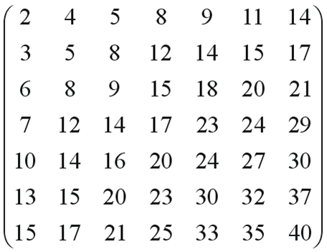
Searching an ordered matrix
Consider an n × n matrix where each row and column is linearly ordered; for example:
How can we determine if 19 is in the matrix?

Slide 12
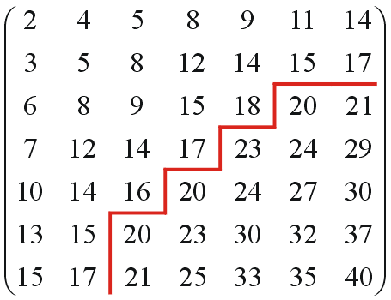
Searching an ordered matrix
Consider the following search for 19:
Search across until a_{i,j + 1} > 19
Alternate between
Searching down until a_{i,j} > 19
Searching back until a_{i,j} < 19
This requires us to check at most 3n entries: O(n)

Slide 13
Searching an ordered matrix
Can we do better than O(n)?
Logically, no: any number could appear in up to n positions, each of which must be checked
Never-the-less: let’s generalize checking the middle entry

Slide 14
Searching an ordered matrix
17 < 19, and therefore, we can only exclude the top-left sub-matrix:

Slide 15
Searching an ordered matrix
Thus, we must recursively search three of the four sub-matrices
Each sub-matrix is approximately n/2 × n/2

Slide 16
Searching an ordered matrix
If the number we are searching for was less than the middle element, e.g., 9, we would have to search three different squares

Slide 17
Searching an ordered matrix
Thus, the recurrence relation must be
because
T(n) is the time to search a matrix of size n × n
The matrix is divided into 4 sub-matrices of size n/2 × n/2
Search 3 of those sub-matrices
At each step, we only need compare the middle element: Θ(1)

Slide 18
Searching an ordered matrix
We can solve the recurrence relationship
using Maple:
> rsolve( {T(n) = 3*T(n/2) + 1, T(1) = 1}, T(n) );
> evalf( log[2]( 3 ) );

Slide 19
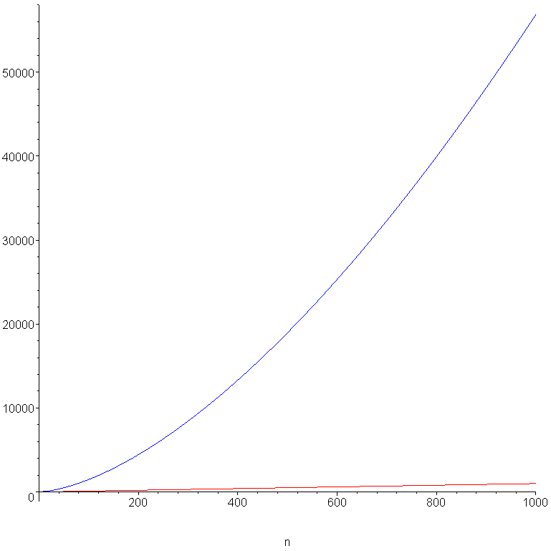
Searching an ordered matrix
Therefore, this search is approximately O(n^{1.585}), which is significantly worse than a linear search:

Slide 20
Searching an ordered matrix
Note that it is
T(n) = 3T(n/2) + Θ(1)
and not
T(n) = 3T(n/4) + Θ(1)
We are breaking the n × n matrix into four (n/2) × (n/2) matrices
If N = n², then we could write
T(N) = 3T(N/4) + Θ(1)

Slide 21
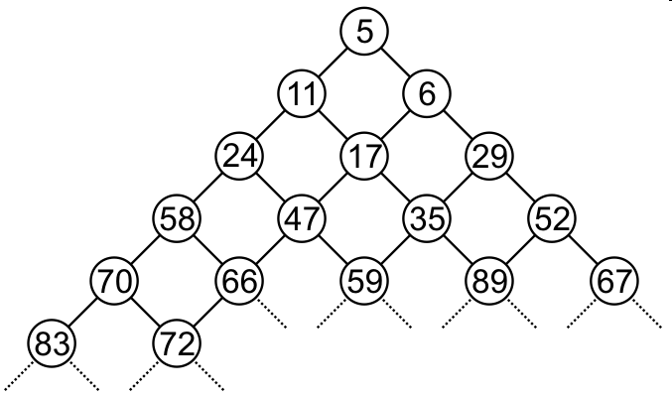
Searching an ordered matrix
Where is such a search necessary?
Consider a bi-parental heap
Without proof, most operations are O( ) including searches
Binary heaps: most operations are O(ln(n)) but searches are O(n)
Notes:
21

Slide 22
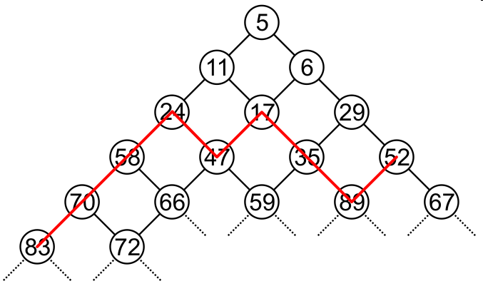
Searching an ordered matrix
For example, consider a search for the value 44:
The matrix has n entries in
See: http://ece.uwaterloo.ca/~dwharder/aads/Algorithms/Beaps/

Slide 23
Searching an ordered matrix
Note: the linear searching algorithm is only optimal for square matrices
A binary search would be optimal for a 1 × n or n × 1 matrix
Craig Gidney posts an interesting discussion on such searches when the matrix is not close to square
http://twistedoakstudios.com/blog/Post5365_searching-a-sorted-matrix-faster

Slide 24
Integer multiplication
Calculate the product of two 16-digit integers
3563474256143563 × 8976558458718976
Multiplying two n-digit numbers requires Θ(n²) multiplications of two decimal digits:
3563474256143563 × 8976558458718976 21380845536861378
24944319793004941
32071268305292067
28507794049148504
3563474256143563
24944319793004941
28507794049148504
17817371280717815
14253897024574252
28507794049148504
17817371280717815
17817371280717815
21380845536861378
24944319793004941
32071268305292067
+ 28507794049148504 .
31987734976412811376690928351488
n

Slide 25
Integer multiplication
Rewrite the product
3563474256143563 × 8976558458718976
as
(35634742 × 10⁸ + 56143563) × (89765584×10⁸ + 58718976)
which requires four multiplications of 8-digit integers:
(35634742 × 89765584)×10¹⁶ +
(35634742 × 58718976 + 56143563 × 89765584)×10⁸ +
(56143563 × 58718976)
Adding two n-digit integers is a Θ(n) operation

Slide 26
Integer multiplication
Thus, the recurrence relation is:
Again, we solve the recurrence relation using Maple:
> rsolve( {T(n) = 4*T(n/2) + n, T(1) = 1}, T(n) );
This is still Θ(n²)

Slide 27
Integer multiplication
To reduce the run time, the Karatsuba algorithm (1961) reduces the number of multiplications
Let
x = 3563474256143563
y = 8976558458718976
and define
x_{MS} = 35634742 x_{LS} = 56143563
y_{MS} = 89765584 y_{LS} = 58718976
and thus
x = x_{MS}×10⁸ + x_{LS}
y = y_{MS}×10⁸ + y_{LS}

Slide 28
Integer multiplication
The multiplication is now:
xy = x_{MS}y_{MS}×10¹⁶ + (x_{L}y_{R} + x_{R}y_{L})×10⁸ + x_{LS}y_{LS}
Rewrite the middle product as
x_{MS}y_{LS} + x_{LS}y_{MS} = (x_{LS} – x_{MS})(y_{LS} – y_{MS}) + x_{MS}y_{MS} + x_{LS}y_{LS}
Two of these are already calculated!

Slide 29
Integer multiplication
Thus, the revised recurrence relation
may again be solved using Maple:
> rsolve( {T(n) = 3*T(n/2) + n, T(1) = 1}, T(n) );
where log₂(3) ≈ 1.585

Slide 30
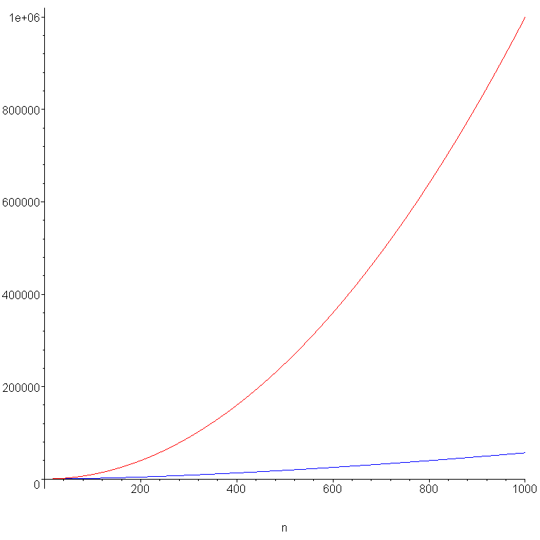
Integer multiplication
Plotting the two functions n² and n^{1.585}, we see that they are significantly different

Slide 31
Integer multiplication
This is the same asymptotic behaviour we saw for our alternate searching behaviour of an ordered matrix, however, in this case, it is an improvement on the original run time!
Even more interesting is that the recurrence relation are different:
T(n) = 3T(n/2) + Θ(n) integer multiplication
T(n) = 3T(n/2) + Θ(1) searching an ordered matrix

Slide 32
Integer multiplication
In reality, you would probably not use this technique: there are others
There are also libraries available for fast integer multiplication
For example, the GNU Image Manipulation Program (GIMP) comes with a complete set of tools for fast integer arithmetic
http://www.gimp.org/

Slide 33
Integer multiplication
The Toom-Cook algorithm (1963 and 1966) splits the integers into k parts and reduces the k² multiplications to 2k – 1
Complexity is Θ(n^{logk(2k – 1)})
Karatsuba is a special case when k = 2
Toom-3 (k = 3) results in a run time of Θ(n^{log3(5)}) = Θ(n^{1.465})
The Schönhage-Strassen algorithm runs in Θ(n ln(n) ln(ln(n))) time but is only useful for very large integers (greater than 10 000 decimal digits)

Slide 34

Matrix multiplication
Consider multiplying two n × n matrices, C = AB
This requires the Θ(n) dot product of each of the n rows of A with each of the n columns of B
The run time must be Θ(n³)
Can we do better?
j
i
c_{i,j}

Slide 35
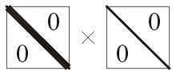
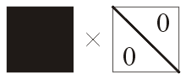
Matrix multiplication
In special cases, faster algorithms exist:
If both matrices are diagonal or tri-diagonal Θ(n)
If one matrix is diagonal or tri-diagonal Θ(n²)
In general, however, this was not believed to be possible to do better

Slide 36

Matrix multiplication
Consider this product of two n × n matrices
How can we break this down into smaller sub-problems?

Slide 37
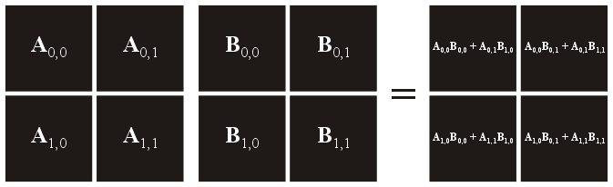
Matrix multiplication
Break each matrix into four (n/2) × (n/2) sub-matrices
Write each sub-matrix of C as a sum-of-products
A
B
C

Slide 38
Matrix multiplication
Justification:
c_{ij} is the dot product of the i^{th} row of A and the j^{th} column of B
c_{i,j}

Slide 39
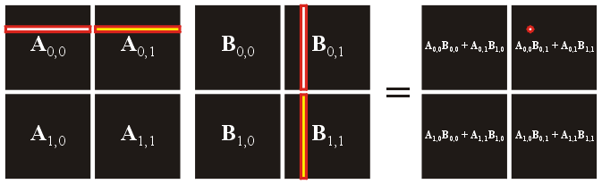
Matrix multiplication
This is equivalent for each of the sub-matrices:

Slide 40
Matrix multiplication
We must calculate the four sums-of-products
C₀₀ = A₀₀B₀₀ + A₀₁B₁₀
C₀₁ = A₀₀B₀₁ + A₀₁B₁₁
C₁₀ = A₁₀B₀₀ + A₁₁B₁₀
C₁₁ = A₁₀B₀₁ + A₁₁B₁₁
This totals 8 products of (n/2) × (n/2) matrices
This requires four matrix-matrix additions: Θ(n²)

Slide 41
Matrix multiplication
The recurrence relation is:
Using Maple:
> rsolve( {T(n) = 8*T(n/2) + n^2, T(1) = 1}, T(n) );

Slide 42
Matrix multiplication
In 1969, Strassen developed a technique for performing matrix-matrix multiplication in Θ(n^{lg(7)}) ≈ Θ(n^{2.807}) time
Reduce the number of matrix-matrix products

Slide 43
Matrix multiplication
Consider the following seven matrix products
M₁ = (A₀₀ – A₁₀)(B₀₀ + B₀₁)
M₂ = (A₀₀ + A₁₁)(B₀₀ + B₁₁)
M₃ = (A₀₁ – A₁₁)(B₁₀ + B₁₁)
M₄ = A₀₀(B₀₁ – B₁₁)
M₅ = A₁₁(B₁₀ – B₀₀)
M₆ = (A₁₀ + A₁₁)B₀₀
M₇ = (A₀₀ + A₀₁)B₁₁
The four sub-matrices of C may be written as
C₀₀ = M₃ + M₂ + M₅ – M₇
C₀₁ = M₄ + M₇
C₁₀ = M₅ + M₆
C₁₁ = M₂ – M₁ + M₄ – M₆

Slide 44
Matrix multiplication
Thus, the new recurrence relation is:
Using Maple:
> rsolve( {T(n) = 7*T(n/2) + n^2, T(1) = 1}, T(n) );

Slide 45
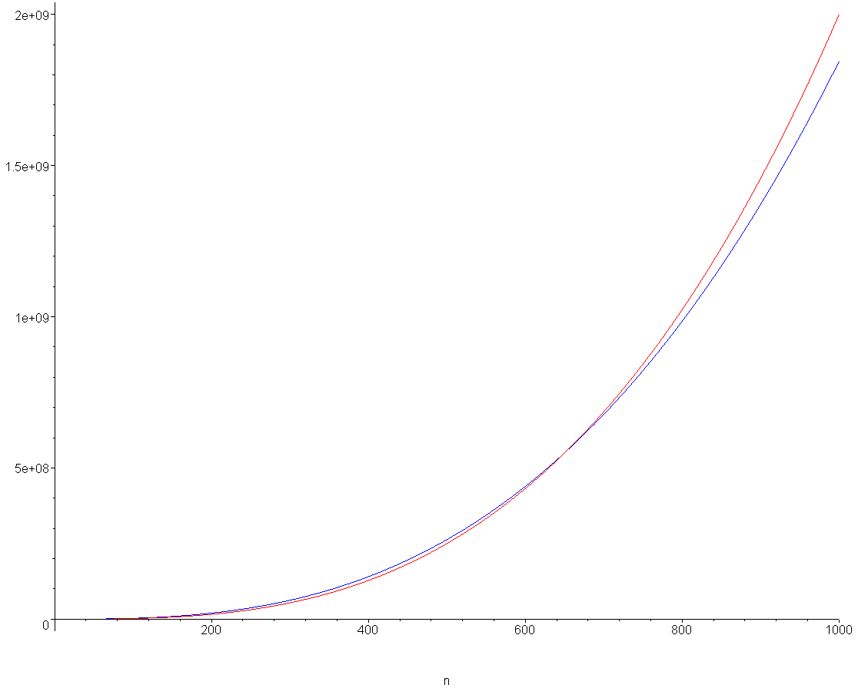
Matrix multiplication
Note, however, that there is a lot of additional work required
Counting additions and multiplications:
Classic 2n³ – n²
Strassen 7n^{lg(7)} – 6 n²

Slide 46
Matrix multiplication
Examining this plot, and then solving explicitly, we find that Strassen’s method only reduces the number of operations for n > 654
Better asymptotic behaviour does not immediately translate into better run-times
The Strassen algorithm is not the fastest
the Coppersmith–Winograd algorithm runs in Θ(n^{2.376}) time but the coefficients are too large for any problem
Therefore, better asymptotic behaviour does not immediately translate into better run-times

Slide 47
Observation
Some literature lists the run-time as O(7^{lg(n)})
Recall that these are equal:
7^{lg(n)} = n^{lg(7)}
Proof:
7^{lg(n)} = (2^{lg(7)}) ^{lg(n)} = 2^{lg(7) lg(n)} = 2^{lg(n) lg(7)} = (2^{lg(n)}) ^{lg(7)} = n ^{lg(7)}

Slide 48
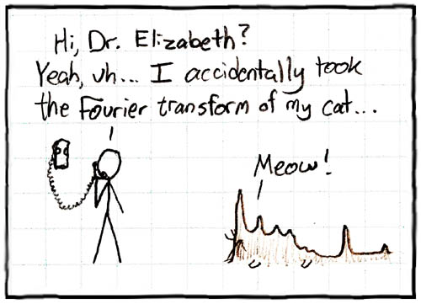
Fast Fourier transform
The last example is the fast Fourier transform
This takes a vector from the time domain to the frequency domain
The Fourier transform is a linear transform
For finite dimensional vectors, it is a matrix-vector product F_{n}x
http://xkcd.com/26/

Slide 49
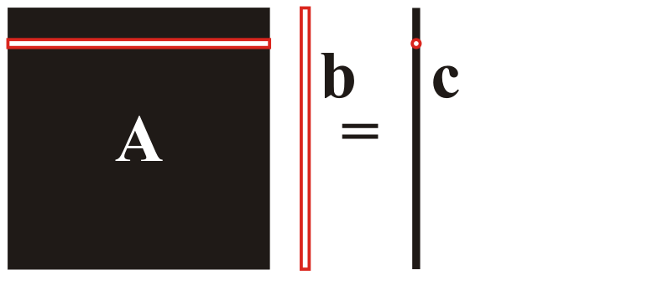
Fast Fourier transform
To perform a linear transformation, it is necessary to calculate a matrix-vector product:

Slide 50
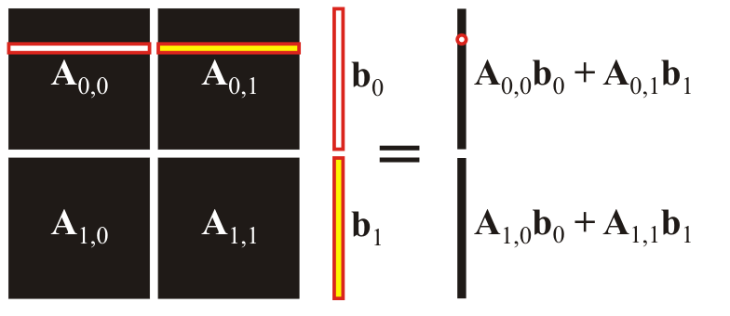
Fast Fourier transform
We can apply a divide and conquer algorithm to this problem
Break the matrix-vector product into four matrix-vector products, each of half the size

Slide 51
Fast Fourier transform
The recurrence relation is:
Using Maple:
> rsolve( {T(n) = 4*T(n/2) + n, T(1) = 1}, T(n) );
n (2 n – 1)

Slide 52
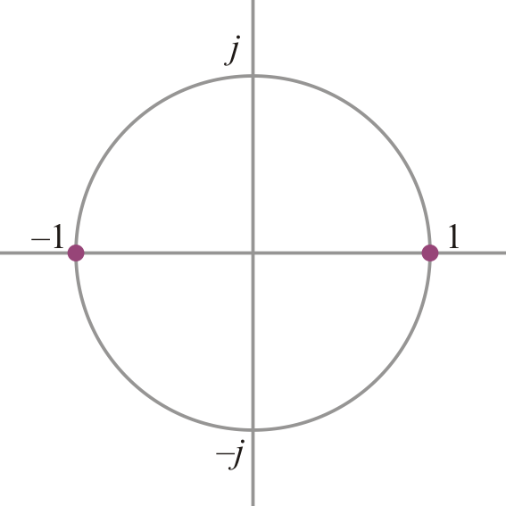
Discrete Fourier transform
To introduce the Fourier transform, we need a little information about complex numbers:
There are two complex numbers z such that z² = 1

Slide 53
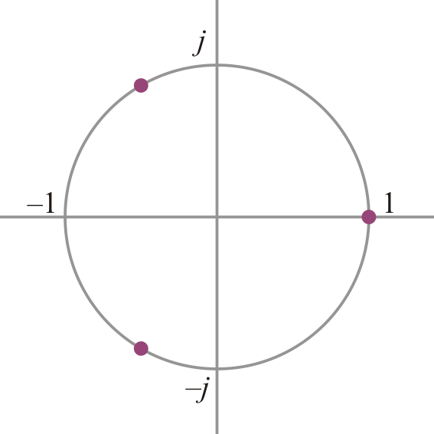
Discrete Fourier transform
To introduce the Fourier transform, we need a little information about complex numbers:
There are three complex numbers z such that z³ = 1

Slide 54
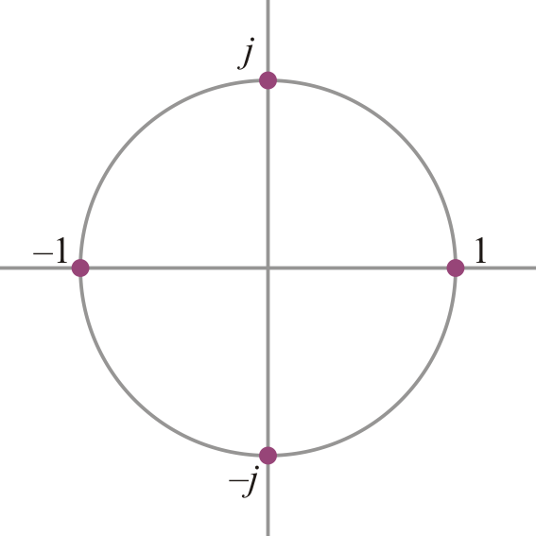
Discrete Fourier transform
To introduce the Fourier transform, we need a little information about complex numbers:
There are four complex numbers z such that z⁴ = 1

Slide 55
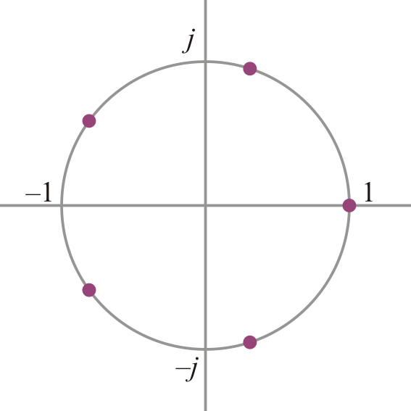
Discrete Fourier transform
To introduce the Fourier transform, we need a little information about complex numbers:
There are five complex numbers z such that z⁵ = 1

Slide 56
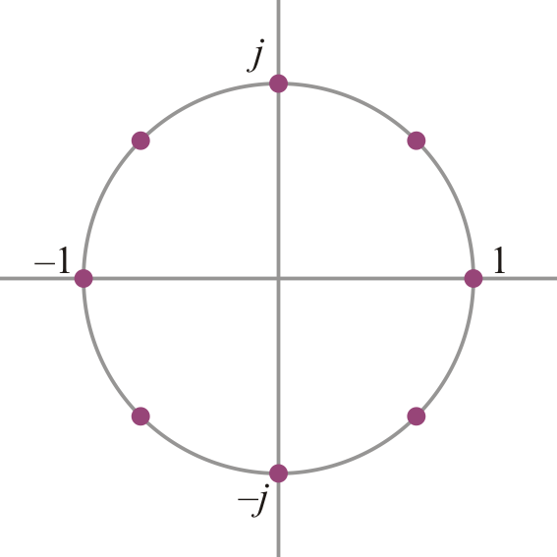
Discrete Fourier transform
To introduce the Fourier transform, we need a little information about complex numbers:
There are eight complex numbers z such that z⁸ = 1
These are also known as the eighth roots of unity
That root with the smallest non-zero angle is said to be the eighth principle root of unity

Slide 57
Discrete Fourier transform
In n dimensions, the
Fourier transform matrix is
where ω = e^{–2πj/n} is the conjugate n^{th} principal root of unity

Slide 58
Discrete Fourier transform
For example, the matrix for the Fourier transform for 4-dimensions is
Here, ω = –j is the conjugate 4th principal root of unity
Note that:
The matrix is symmetric
All the column/row vectors are orthogonal
These create a orthogonal basis for C⁴

Slide 59
Discrete Fourier transform
Any matrix-vector multiplication is usually Θ(n²)
The discrete Fourier transform is a useful tool in all fields of engineering
In general, it is not possible to speed up a matrix-vector multiplication
In this case, however, the matrix has a peculiar shape
That of a very special Vandermonde matrix

Slide 60
Fast Fourier transform
We will now look at the Cooley–Tukey algorithm for calculating the discrete Fourier transform
This fast transform can only be applied the dimension is a power of two
We will look at the 8-dimensional transform matrix
The eighth conjugate root of unity is
Note that ω² = –j, ω⁴ = –1 and ω⁸ = 1

Slide 61
Fast Fourier transform
This is the 8 × 8 Fourier transform matrix
We will write ω⁰ instead of 1 so that we can see the pattern
We will number the columns 0, 1, 2, …, 7

Slide 62
Fast Fourier transform
Now by definition, ω⁸ = 1, so we can make some simplifications
For example, ω¹⁴ = ω⁸ ⁺ ⁶ = ω⁸ω⁶ = ω⁶
We may use, ω^{n} = ω^{n mod 8}
For example, ω⁴⁹ = ω^{49 mod 8} = ω¹

Slide 63
Fast Fourier transform
Now we’ve simplified the matrix with powers on the range 0 to 7

Slide 64
Fast Fourier transform
As 8 is even, ω⁴ = –1
Thus, we replace ω⁴ = –ω⁰ ω⁵ = –ω¹ ω⁶ = –ω² ω⁷ = –ω³

Slide 65
Fast Fourier transform
Now we may observe some patterns

Slide 66

Fast Fourier transform
Note that the even columns (0, 2, 4, 6) are powers of ω ²
Note also that
If ω is the eighth conjugate root of unity, ω² is the fourth conjugate root of unity

Slide 67
Fast Fourier transform
The shape of the odd columns (1, 3, 5, 7) is less obvious

Slide 68
Fast Fourier transform
Let’s rearrange the columns of the matrix and the entries of the vector
1
3
5
7
0
2
4
6

Slide 69
Fast Fourier transform
Recall that ω is the 8th conjugate root of unity
Therefore, ω² is the 4th conjugate root of unity
Both these matrices are the Fourier transform for a 4-dimensional vector

Slide 70
Fast Fourier transform
We will label these two blocks as F₄
F₄
F₄

Slide 71
Fast Fourier transform
There is one obvious pattern in the second pair of matrices
The bottom matrix is the negative of the top
The other pattern is more subtle
F₄
F₄

Slide 72
Fast Fourier transform
The top matrix is a diagonal multiplied by F₄
F₄
F₄

Slide 73
Fast Fourier transform
Represent that diagonal matrix by
Recall that multiplying a vector by a diagonal matrix is Θ(n)
F₄
D₄F₄
F₄

Slide 74
Fast Fourier transform
From our previous observation, the bottom matrix is –D₄F₄
F₄
D₄F₄
F₄
–D₄F₄

Slide 75
Fast Fourier transform
Thus, our adjusted Fourier transform matrix is a block matrix consisting of four 4 × 4 matrices
F₄
D₄F₄
F₄
–D₄F₄

Slide 76
Fast Fourier transform
Let’s split up the vector into two vectors
F₄
D₄F₄
F₄
–D₄F₄

Slide 77
Fast Fourier transform
4 × 4 matrices
Thus, we have the relation:
Thus,
Note that we want to calculate and not
The first is Θ(n + T_{F}(n)), the second Θ(n² + T_{F}(n))
That is, calculate the FFT of (a vector) and then multiply the entries of that vector by the diagonal entries
4-dimensional vectors

Slide 78
Fast Fourier transform
Now we must calculate and recursively
Calculating and are both Θ(n) operations
Adding and are also both Θ(n)
Rearranging the results is also Θ(n)

Slide 79
Fast Fourier transform
Thus, we have that the time T(n) requires that we
Divide the vector v into the vectors and
Calculate and recursively
Calculate and
Add and
Reorder the results to get the result F₈v
The recurrence relation now
This is the run-time of merge sort: Θ(n ln(n))
Θ(n)
2 T(n/2)
Θ(n)
Θ(n)
Θ(n)

Slide 80
Fast Fourier transform
An argument that this generalizes for other powers of two:
The even columns of are powers of ω²
ω⁰ ω² ω⁴ ω⁶ ω⁸ ···
ω⁰ ω⁴ ω⁸ ω¹² ω¹⁶ ···
The normalized bottom halves equal the top halves
The odd columns are of the form
ω⁰ ω³ ω⁶ ω⁹ ω¹² ···
ω⁰ ω⁵ ω¹⁰ ω¹⁵ ω²⁰ ···
These can be written as
ω⁰·ω⁰ ω¹·ω² ω²·ω⁴ ω³· ω⁶ ω⁴· ω⁸ ···
ω⁰·ω⁰ ω¹·ω⁴ ω²·ω⁸ ω³·ω¹² ω⁴·ω¹⁶ ···
The normalized bottom halves are the top halves multiplied by

Slide 81
Fast Fourier transform
void FFT( std::complex<double> *array, int n ) {
if ( n == 1 ) return;
std::complex<double> even[n/2];
std::complex<double> odd[n/2];
for ( int k = 0; k < n/2; ++k ) {
even[k] = array[2*k];
odd[k] = array[2*k + 1];
}
FFT( even, n/2 );
FFT( odd, n/2 );
double const PI = 4.0*std::atan( 1.0 );
std::complex<double> w = 1.0;
std::complex<double> wn = std::exp( std::complex<double>( 0.0, -2.0*PI/n ) );
for ( int k = 0; k < n/2; ++k ) {
array[k] = even[k] + w*odd[k];
array[n/2 + k] = even[k] - w*odd[k];
w = w * wn;
}
}

Slide 82
Divide and Conquer
We have now looked at a number of divide-and-conquer algorithms, and come up with a number of different run times:
Binary search T(n) = T(n/2) + Θ(1) O(ln(n))
Tree traversals T(n) = 2T(n/2) + Θ(1) Θ(n)
Merge sort T(n) = 2T(n/2) + Θ(n) Θ(n ln(n))
Ordered-matrix search T(n) = 3T(n/2) + Θ(1) O(n^{lg(3)})
Integer multiplication T(n) = 3T(n/2) + Θ(n) Θ(n^{lg(3)})
Toom-3 integer multiplication T(n) = 5T(n/3) + Θ(n) Θ(n^{log3(5)})
Matrix multiplication T(n) = 7T(n/2) + Θ(n²) Θ(n^{lg(7)})
Fast Fourier transform T(n) = 2T(n/2) + Θ(n) Θ(n ln(n))

Slide 83
The master theorem
We used Maple to solve the recurrence relationships
We will now solve the general problem

Slide 84
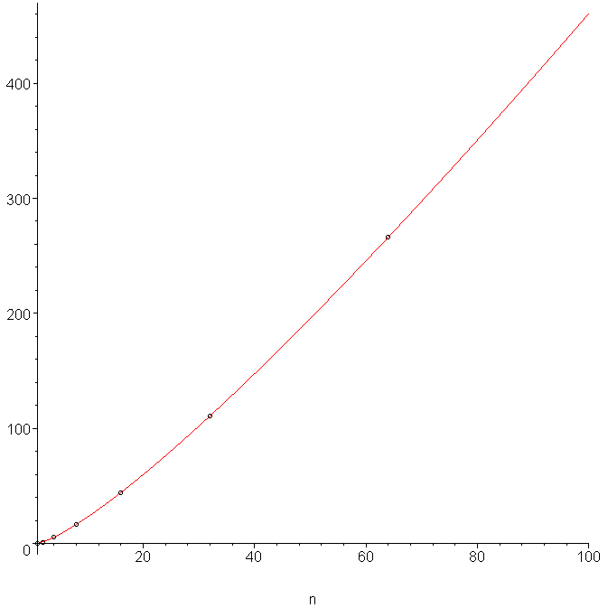
The master theorem
In all cases when b = 2, we assumed n = 2^{m}
That is, n = 1, 2, 4, 8, 16, 32, 64, ....
and interpolated the intermediate results

Slide 85
The master theorem
In this case, we will assume n = b^{m}, as we are dividing each interval into b equal parts
n = 1, b, b², b³, ...
As before, we will interpolate intermediate behaviour
Thus, we will solve T(b^{m}) and use this to approximate T(n)

Slide 86
The master theorem
Thus, given the recurrence relation
we have that
We can rewrite this as:
b^{k} is a constant

Slide 87
The master theorem
Therefore, we may iterate:

Slide 88
The master theorem
Determining a pattern is possible, however, we can determine the pattern more easily if we divide both sides by a^{m}:
We can simplify this to:

Slide 89
The master theorem
We can repeatedly calculate this formula for smaller and smaller values of m:

Slide 90
The master theorem
Thus, we may carry on

Slide 91
The master theorem
A telescoping series is any series of the form
Alternatively, if , it follows that
More generally, we have:

Slide 92
The master theorem
Thus, we find:
+

Slide 93
The master theorem
We can sum these:
and simplify:

Slide 94
The master theorem
We multiply by a^{m} to get

Slide 95
The master theorem
The sum is a geometric series, and the actual value will depend on the ratio
Recall that for a geometric series, if r < 1 then the series converges:

Slide 96
The master theorem
Also, if r = 1, we have:
If r > 1, we can only determine a finite sum:

Slide 97
The master theorem
Thus, we consider three possible cases

Slide 98
The master theorem
These may be roughly translated into:
The number of recursions at each step is more significant than the amount of work at each step (b^{k} < a)
The contributions are equal (b^{k} = a)
The amount of work at each step is more significant than the additional work contributed by the recursion (b^{k} > a)

Slide 99
b^{k} < a
Which examples fall in this case?
 | a | b | k | b^{k}
Traversal | 2 | 2 | 0 | 1
Quaternary search of an ordered matrix | 3 | 2 | 0 | 1
Karatsuba’s integer-multiplication algorithm | 3 | 2 | 1 | 2
Toom-3 integer-multiplication algorithm | 5 | 3 | 1 | 3
Strassen’s matrix-multiplication algorithm | 7 | 2 | 2 | 4

Slide 100
b^{k} < a
In this case,
where is a constant
which we may asymptotically ignore

Slide 101
b^{k} < a
Therefore, T(n) = O(a^{m})
By assumption, n = b^{m}, hence m =log_{b}n and therefore
T(n) = O(a^{logbn}) = O(n^{logba})

Slide 102
b^{k} < a
Going back to our examples:
 | a | b | k | b^{k} | log_{b}(a) | Run time
Traversal | 2 | 2 | 0 | 1 | 1.000 | O(n)
Quaternary search of an ordered matrix | 3 | 2 | 0 | 1 | 1.585 | O(n^{1.585})
Karatsuba’s integer-multiplication algorithm | 3 | 2 | 1 | 2 | 1.465 | O(n^{1.585})
Toom-3 integer-multiplication algorithm | 5 | 3 | 1 | 3 | 1.465 | O(n^{1.465})
Strassen’s matrix-multiplication algorithm | 7 | 2 | 2 | 4 | 2.807 | O(n^{2.807})

Slide 103
b^{k} = a
Which examples fall in this case?
 | a | b | k | b^{k}
Binary search | 1 | 2 | 0 | 1
Merge sort | 2 | 2 | 1 | 2
Fast Fourier transform | 2 | 2 | 1 | 2

Slide 104
b^{k} = a
In this case,
Therefore, T(n) = O(ma^{m})
By assumption, n = b^{m} and a = b^{k} ∴ m = log_{b}n and k = log_{b}a
Hence

Slide 105
b^{k} = a
Going back to our examples:
 | a | b | k | b^{k} | Run time
Binary search | 1 | 2 | 0 | 1 | O(1·ln(n))
Merge sort | 2 | 2 | 1 | 1 | O(n ln(n))
Fast Fourier transform | 2 | 2 | 1 | 2 | O(n ln(n))

Slide 106
b^{k} > a
We haven’t seen any examples that fall into this case
Suppose we divide the problem into two, but we must perform a linear operation to determine which half to recursively call
 | a | b | k | b^{k}
Sample | 1 | 2 | 1 | 2

Slide 107
b^{k} > a
In this case,
Factor out the constant term and simplify to get:
Both positive constants (see assumption)

Slide 108
b^{k} > a
Recall that if p < q then p^{m} = o(q^{m}), hence
a^{m} = o((b^{k})^{m})
Thus, we can ignore the second term:
T(n) = O(b^{km} – a^{m}) = O(b^{km})
Again, by assumption, n = b^{m}, hence
T(n) = O((b^{m})^{k}) = O(n^{k})

Slide 109
b^{k} > a
Going back to our example:
The linear operation contributes more than the divide-and-conquer component
 | a | b | k | b^{k} | Run time
Sample | 1 | 2 | 1 | 2 | O(n¹)

Slide 110
Summary of cases
To summarize these run times:

Slide 111
Summary
Therefore:
If the amount of work being done at each step to either sub-divide the problem or to recombine the solutions dominates, then this is the run time of the algorithm: O(n^{k})
If the problem is being divided into many small sub-problems (a > b^{k}) then the number of sub-problems dominates: O(n^{logb(a)})
In between, a little more (logarithmically more) work must be done

Slide 112
References
Wikipedia, http://en.wikipedia.org/wiki/Divide_and_conquer
These slides are provided for the ECE 250 Algorithms and Data Structures course. The material in it reflects Douglas W. Harder’s best judgment in light of the information available to him at the time of preparation. Any reliance on these course slides by any party for any other purpose are the responsibility of such parties. Douglas W. Harder accepts no responsibility for damages, if any, suffered by any party as a result of decisions made or actions based on these course slides for any other purpose than that for which it was intended.

